Slide 1
PES/PELS/IAS/IES Ausin (PI)²
Tech Meetings on 4th Tuesdays, Jan - Oct

Slide 2
2017 ChapCom
Chair – James J. Mercier, P.E.
Vice Chair/Chair Elect – Steve Pearson
Treasurer – Kris Dehnel
Secretary – Ruth Sulzer, P.E.
Member–at–large – Marcie Gard, P.E.
Member–at–large – Xin “Wendy” Wang
Member–at–large – Franklin Bohac, P.E.
Awards Chair – Andrew Bluiett, P.E.
Comm Chair – Steve Pearson

Slide 3
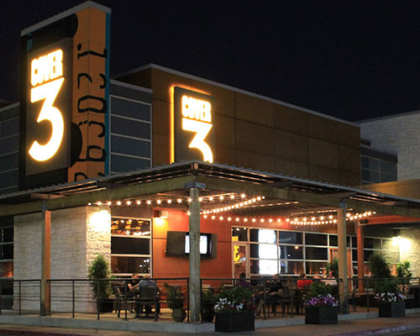
NEW MEETING LOCATION!
2700 W. Anderson Lane, 78757

Slide 4
New meeting location required a new check-in format.
Attendees now merely sign in with the Secretary, but order from the Server.
BUT, we need a minimum order $500 food and drinks to get room.
Does not include server fee or tax.
If light, (PI)² pays balance!

Slide 5
Weaknesses
Strengths
Robust schedule: 10 Tech meetings, 11 Chapcom meetings, 1 Workshop, 4 tours, 1 or 2 Social events, and a dynamic Chapcom that includes active Past Chairs.
Declining attendance –
Cost of meals? (necessary for quality meeting room)
Demanding work environment?
Austin Traffic?

Slide 6
Challenges
1. Improving attendance by developing a stable audience.
2. Finding new and interesting subjects to attract attendance.
3. Finding interesting and available tours for our members.
4. Getting UT Students to recognize our meetings, not just those few seeking jobs!

